Slide 1

Combustion
Content
2.1 1st Law of thermodynamics applied to combustion
enthalpies of reaction, flame temperatures
2.2 Enthalpy and Entropy in Combustion Reactions
Absolute Entropy, Enthalpy of Formation and Hess’ Law
2.3 Chemical equilibrium in combusting systems
Application of 2nd Law of Thermodynamics
Dissociation in reacting systems and the Equilibrium Constant
Revision notes on combustion reactions on Moodle.

Slide 2


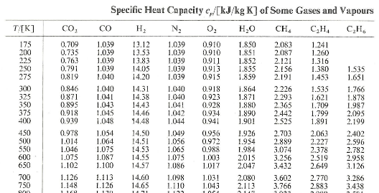
Combustion – Lecture 1
Learning outcomes:
Understand how to apply 1st Law of thermodynamics (SFEE) to combustion using enthalpies of reaction
Understand how to calculate a flame temperature.
Understand how to use tables of molar enthalpy in combustion calculations.
Understand concepts of : Absolute Entropy, Enthalpy of Formation and Hess’s Law

Slide 3
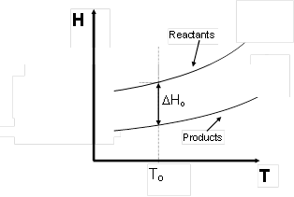
Combustion
Q + W = H_{P} – H_{R}
If T_{R} = T_{p} = T₀ 25°C then:
= Molar enthalpy of combustion.
It’s a negative number.

Slide 4
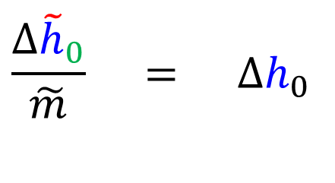




Notation:
Wavy line is molar
Lower case is specific
Subscript 0 is standard state
Negative, - is out of system
Combustion
$$\frac{Δ{\tilde{h}}_{0}}{\tilde{m}} = Δh_{0}$$
Physical form of reactants and products is important, example benzene from the tables:
of C₆H₆ vapour = -3 169 540 kJ/kmol water as vapour in products
of C₆H₆ liquid = -3 135 740 kJ/kmol water as vapour in products
of C₆H₆ vapour = -3 301 510 kJ/kmol water as liquid in products
$$Δ{\tilde{h}}_{o}$$
$$Δ{\tilde{h}}_{o}$$
$$Δ{\tilde{h}}_{o}$$
$$−Δh_{o}$$
Calorific value =
Higher (or gross) calorific value (HCV) - water as a liquid in products
Lower (or net) calorific value (LCV) - water as a vapour in products

Slide 5
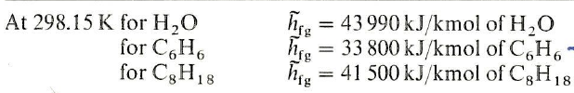
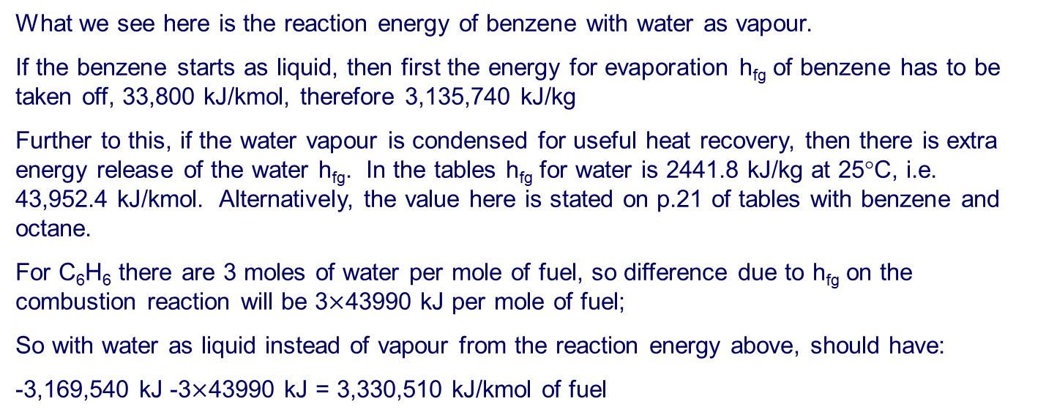
Of vapour and liquid
What we see here is the reaction energy of benzene with water as vapour.
If the benzene starts as liquid, then first the energy for evaporation h_{fg} of benzene has to be taken off, 33,800 kJ/kmol, therefore 3,135,740 kJ/kg
Further to this, if the water vapour is condensed for useful heat recovery, then there is extra energy release of the water h_{fg}. In the tables h_{fg} for water is 2441.8 kJ/kg at 25°C, i.e. 43,952.4 kJ/kmol. Alternatively, the value here is stated on p.21 of tables with benzene and octane.
For C₆H₆ there are 3 moles of water per mole of fuel, so difference due to h_{fg} on the combustion reaction will be 3$×$43990 kJ per mole of fuel;
So with water as liquid instead of vapour from the reaction energy above, should have:
-3,169,540 kJ -3$×$43990 kJ = 3,330,510 kJ/kmol of fuel

Slide 6
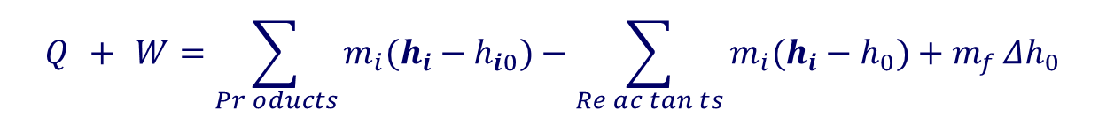
Combustion
Reactants and products at different temperatures
Q + W = H_{P} – H_{R}
Q + W = (H_{P} - H_{P0}) - (H_{R} - H_{R0}) + (H_{P0} - H_{R0})
m_{f} Δh_{o} combustion enthalpy
$$Q + W=\sum_{\operatorname{Pr}{o}ducts}{m_{i}(h_{i}−h_{i0})}−\sum_{\operatorname{Re}{a}c\tan{t}s}{m_{i}(h_{i}−h_{0})+m_{f}}Δh_{0}$$

Slide 7
Combustion
For perfect gases, use:
Use mean c_{p} over temperature range.
Note for water close to saturation and when there is a phase change use enthalpies from steam tables.

Slide 8
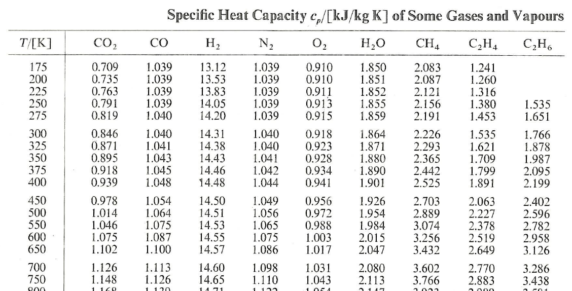
Sample of c_{p} from tables – varying with temperature

Slide 9
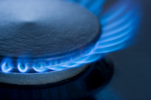
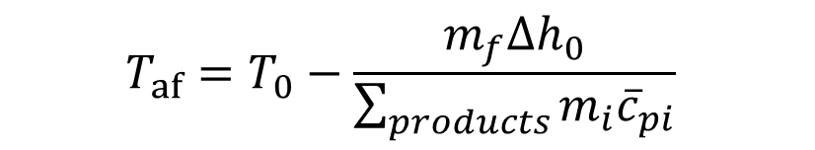

Combustion
Adiabatic Flame Temperature
Maximum possible temperature in a flame
Q + W = (H_{P} - H_{P0}) - (H_{R} - H_{R0}) + (H_{P0} - H_{R0}) (if initial temp = 25 ºC)
$$0=\sum_{products}{{m_{i}\overline{c}}_{pi}\left(T_{p}−T_{0}\right)}−0−{m_{f}∆h}_{0}$$
$$T_{af}=T_{0}−\frac{{m_{f}∆h}_{0}}{\sum_{products}{{m_{i}\overline{c}}_{pi}}}$$

Slide 10
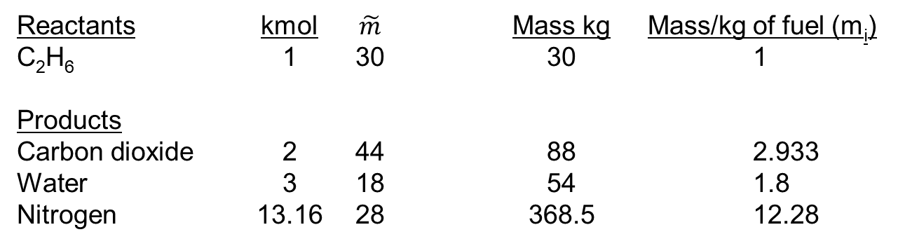
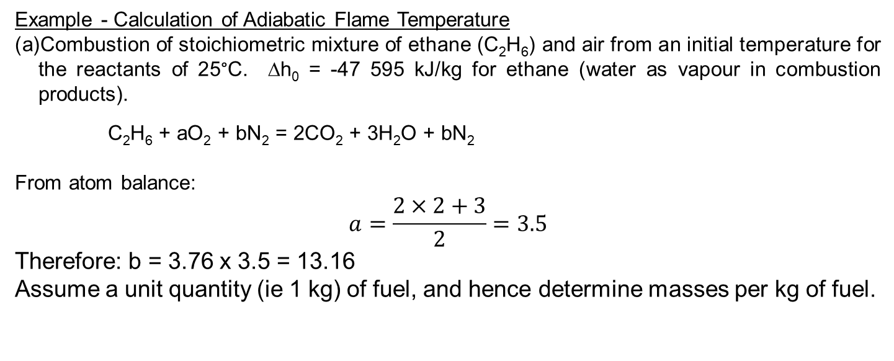
Combustion
2.1
Example - Calculation of Adiabatic Flame Temperature
Combustion of stoichiometric mixture of ethane (C₂H₆) and air from an initial temperature for the reactants of 25°C. Δh₀ = -47 595 kJ/kg for ethane (water as vapour in combustion products).
C₂H₆ + aO₂ + bN₂ = 2CO₂ + 3H₂O + bN₂
From atom balance:
$$a=\frac{2×2+3}{2}=3.5$$
Therefore: b = 3.76 x 3.5 = 13.16
Assume a unit quantity (ie 1 kg) of fuel, and hence determine masses per kg of fuel.
Reactants kmol $\tilde{m}$ Mass kg Mass/kg of fuel (m_{i})
C₂H₆ 1 30 30 1
Products
Carbon dioxide 2 44 88 2.933
Water 3 18 54 1.8
Nitrogen 13.16 28 368.5 12.28

Slide 11
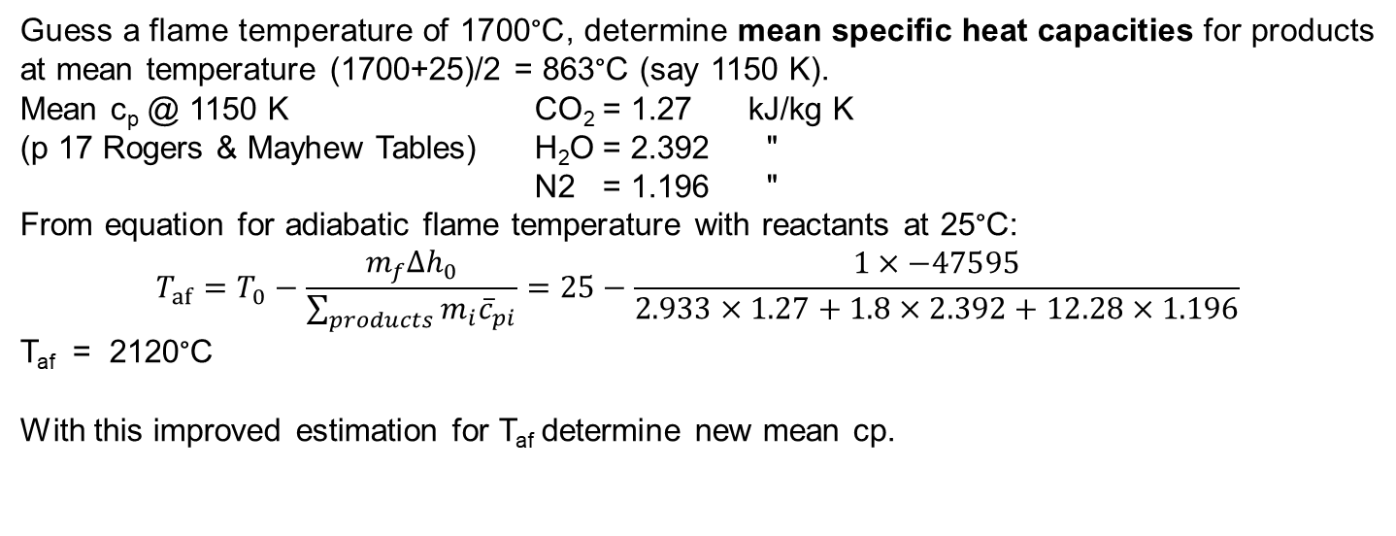
Combustion
2.1
Guess a flame temperature to find a temperature to look up c_{p}
Guess a flame temperature of 1700°C, determine mean specific heat capacities for products at mean temperature (1700+25)/2 = 863°C (say 1150 K).
Mean c_{p} @ 1150 K CO₂ = 1.27 kJ/kg K
(p 17 Rogers & Mayhew Tables) H₂O = 2.392 "
N2 = 1.196 "
From equation for adiabatic flame temperature with reactants at 25°C:
$$T_{af}=T_{0}−\frac{{m_{f}∆h}_{0}}{\sum_{products}{{m_{i}\overline{c}}_{pi}}}=25−\frac{1×−47595}{2.933×1.27+1.8×2.392+12.28×1.196}$$
T_{af} = 2120°C
With this improved estimation for T_{af} determine new mean cp.

Slide 12
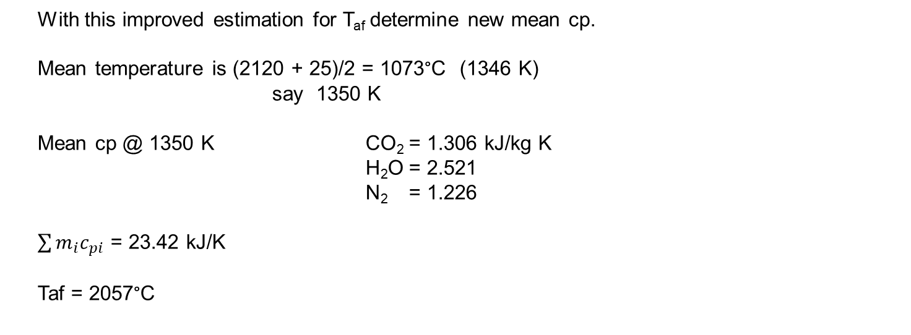
Combustion
2.1
Guess a flame temperature to find a temperature to look up c_{p}
With this improved estimation for T_{af} determine new mean cp.
Mean temperature is (2120 + 25)/2 = 1073°C (1346 K)
say 1350 K
Mean cp @ 1350 K CO₂ = 1.306 kJ/kg K
H₂O = 2.521
N₂ = 1.226
$\sum{m_{i}c_{pi}}$ = 23.42 kJ/K
Taf = 2057°C
Actual flame temperature is always lower – due to heat transfer from the flame and dissociation

Slide 13
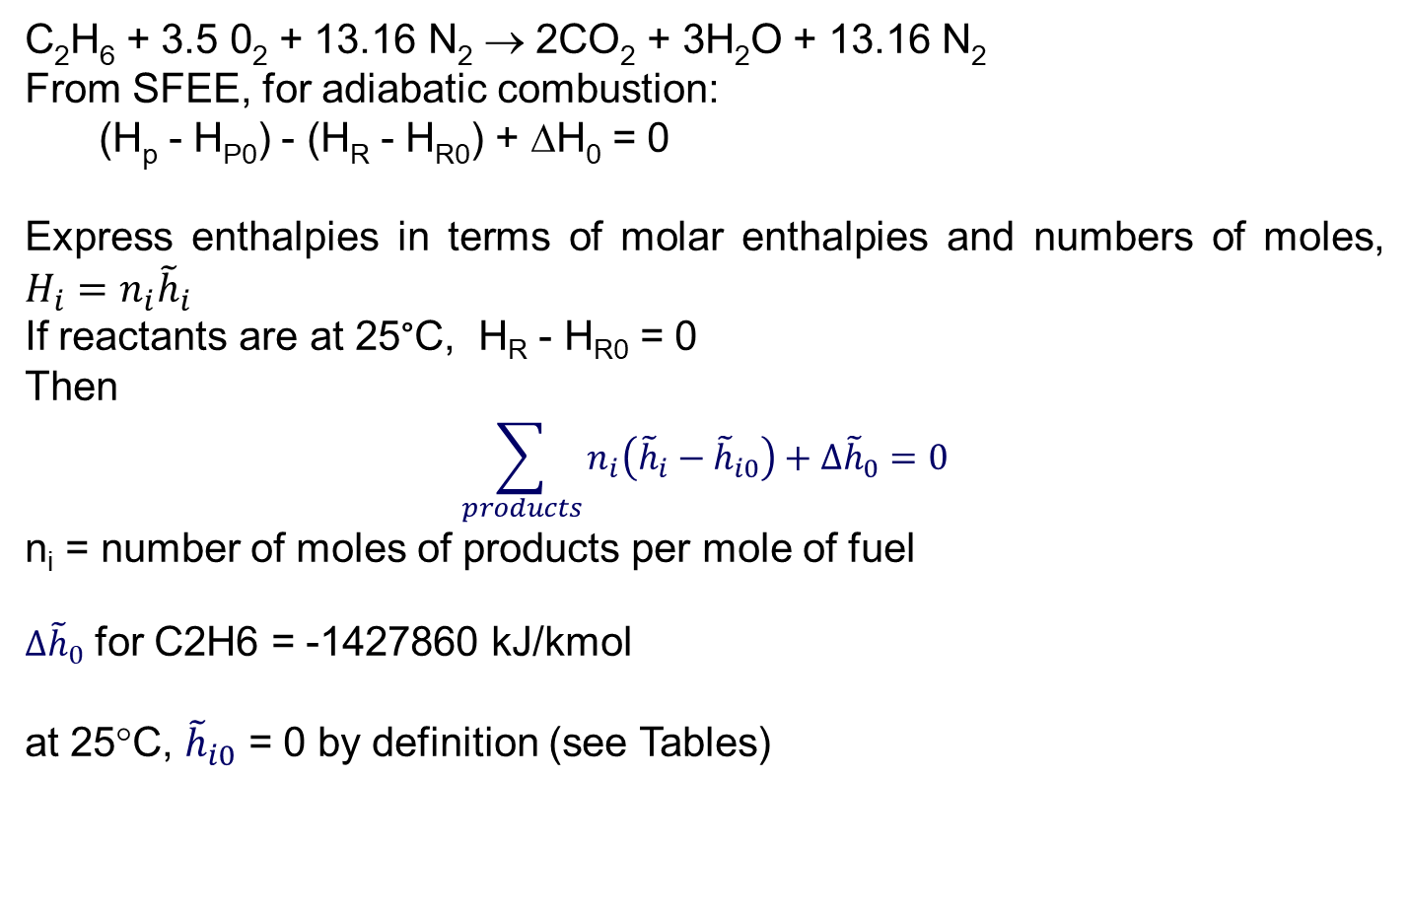
Combustion
Use of Molar Enthalpy - Tables p 18-20
Work directly from combustion equation – no need to convert to mass
C₂H₆ + 3.5 0₂ + 13.16 N₂ → 2CO₂ + 3H₂O + 13.16 N₂
From SFEE, for adiabatic combustion:
(H_{p} - H_{P0}) - (H_{R} - H_{R0}) + ΔH₀ = 0
Express enthalpies in terms of molar enthalpies and numbers of moles, $H_{i}=n_{i}{\tilde{h}}_{i}$
If reactants are at 25°C, H_{R} - H_{R0} = 0
Then
$$\sum_{products}{n_{i}\left({\tilde{h}}_{i}−{\tilde{h}}_{i0}\right)}+∆{\tilde{h}}_{0}=0$$
n_{i} = number of moles of products per mole of fuel
$∆{\tilde{h}}_{0}$ for C2H6 = -1427860 kJ/kmol
at 25°C, ${\tilde{h}}_{i0}$ = 0 by definition (see Tables)

Slide 14
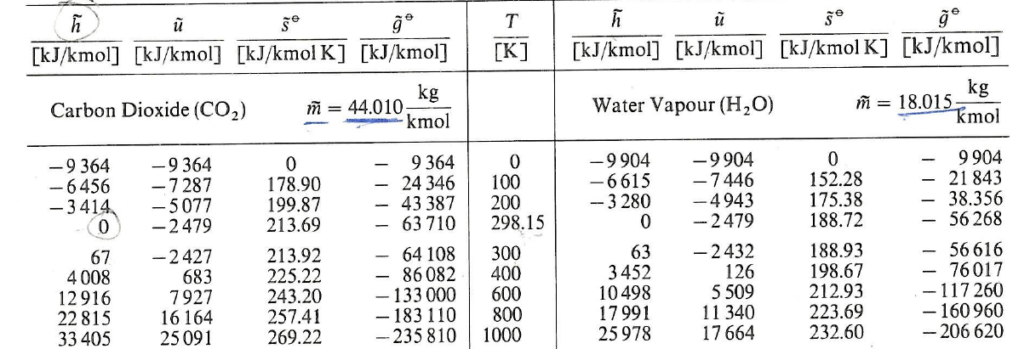
State enthalpy from tables – zero at 25C, 298.15K

Slide 15
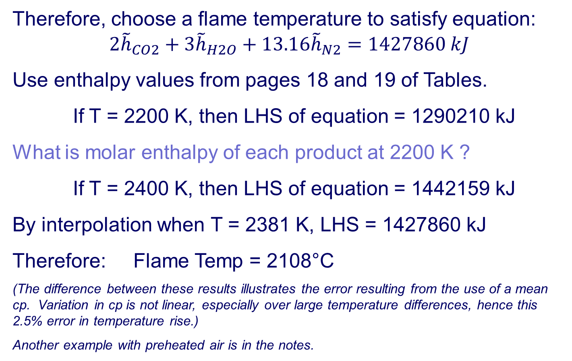
Combustion
Therefore, choose a flame temperature to satisfy equation:
$$2{\tilde{h}}_{CO2}+3{\tilde{h}}_{H2O}+13.16{\tilde{h}}_{N2}=1427860 kJ$$
Use enthalpy values from pages 18 and 19 of Tables.
If T = 2200 K, then LHS of equation = 1290210 kJ
What is molar enthalpy of each product at 2200 K ?
If T = 2400 K, then LHS of equation = 1442159 kJ
By interpolation when T = 2381 K, LHS = 1427860 kJ
Therefore: Flame Temp = 2108°C
(The difference between these results illustrates the error resulting from the use of a mean cp. Variation in cp is not linear, especially over large temperature differences, hence this 2.5% error in temperature rise.)
Another example with preheated air is in the notes.

Slide 16
Combustion
More about Enthalpy and Entropy in Combustion
Third Law of Thermodynamics – absolute entropy
Entropy of all substances (elements and compounds) is zero at 0 K.
Entropies given in Tables p18-20 at 1 bar.
For gases at other pressures use:

Slide 17
State entropy from tables – zero at 0K, -273.15K
Convenient reference temperature defined for enthalpy based on typical atmospheric conditions for combustion
Entropy zero point is a fact of nature

Slide 18
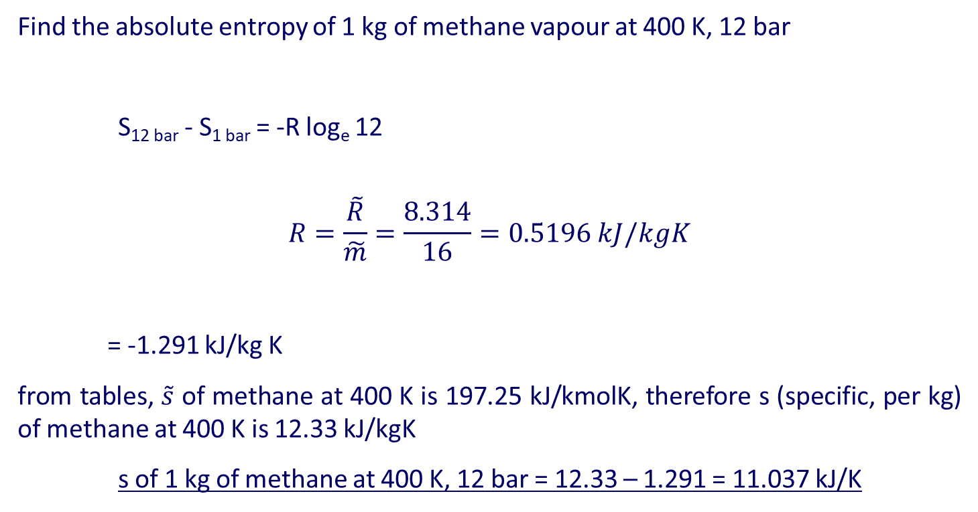
Example on entropy at pressure and temperature
Although enthalpy doesn’t change significantly with pressure, entropy does
Find the absolute entropy of 1 kg of methane vapour at 400 K, 12 bar
S_{12 bar} - S_{1 bar} = -R log_{e} 12
$$R=\frac{\tilde{R}}{\tilde{m}}=\frac{8.314}{16}=0.5196 kJ/kgK$$
= -1.291 kJ/kg K
from tables, $\tilde{s}$ of methane at 400 K is 197.25 kJ/kmolK, therefore s (specific, per kg) of methane at 400 K is 12.33 kJ/kgK
s of 1 kg of methane at 400 K, 12 bar = 12.33 – 1.291 = 11.037 kJ/K

Slide 19
Combustion
More about Enthalpy and Entropy in Combustion
Enthalpy of Formation – Hess’s Law
Allow for enthalpy changes in reactions using enthalpy of combustion. (need to know reaction enthalpy for each reaction) - we’ve just done this!
Use enthalpy of formation to give enthalpies of reactants and products.
Enthalpy of formation of elements in their standard state (i.e. some elements are standard as diatomic molecules) is defined as being zero at 25°C, 1 bar.

Slide 20
Combustion
2.2
Hess’s Law: ΔH₀ = H_{f0 reactants} – H_{f0 products}
H
Reactants C_{x}H_{y}, O₂
ΔH_{0 reaction}
H_{f0 reactants}
Products CO₂, H₂O
H_{f0 products}
Elements C, O_{2,} H₂

Slide 21

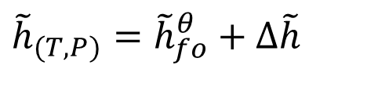

Combustion
2.2
Enthalpy
$${\tilde{h}}_{(T,P)}={\tilde{h}}_{fo}^{θ}+Δ\tilde{h}$$
$${\tilde{h}}_{fo}^{θ}$$
Enthalpy of formation of compound from it’s elements at 25°C, 1 bar.
Change in enthalpy of compound to bring it to actual T and P.
= c_{p} ΔT for gases.
Note: enthalpy of gases does not change significantly with pressure.
$$Δ\tilde{h}$$

Slide 22
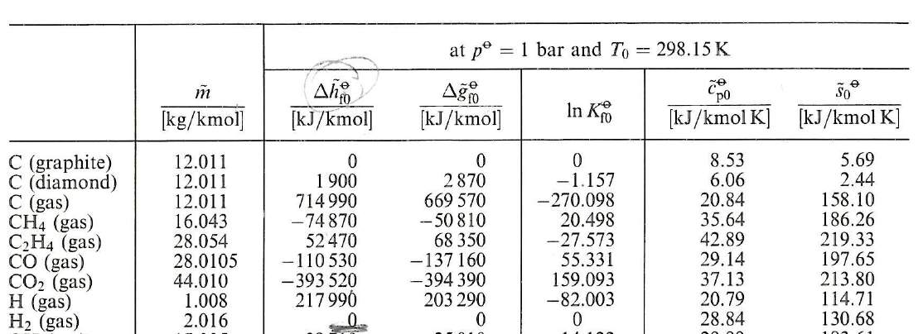
~
Selection of species showing formation enthalpy, Δh^{θ}_{f0}
Some are positive, some are negative…. What does it mean?
If in doubt look at CO₂ being formed from C and O₂ and think which way energy goes from the reactants.

Slide 23
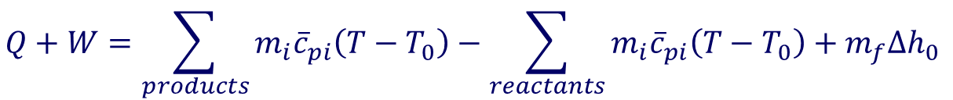

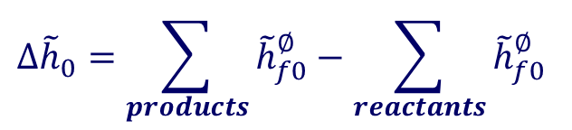
Combustion
2.2
Two methods to use SFEE for combustion:
Use enthalpy of formation
Enthalpy of reaction is included in enthalpy change
Use enthalpy of reaction
$$Q+W=\sum_{products}{m_{i}{\overline{c}}_{pi}\left(T−T_{0}\right)}−\sum_{reactants}{m_{i}{\overline{c}}_{pi}\left(T−T_{0}\right)}+m_{f}∆h_{0}$$
$$∆{\tilde{h}}_{0}=\sum_{products}{{\tilde{h}}_{f0}^{∅}}−\sum_{reactants}{{\tilde{h}}_{f0}^{∅}}$$
$$∆\tilde{h}=\tilde{h}−{\tilde{h}}_{0}$$

Slide 24
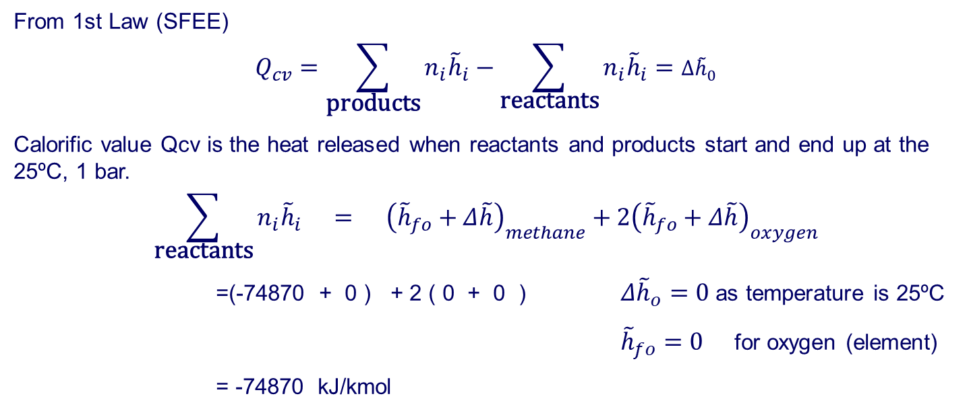
Combustion
2.2
Example
Calculate gross calorific value of methane using enthalpies of formation
CH₄ + 2O₂ → CO₂ + 2H₂O _{(liquid)}
For CV calculation, reactants and products are at 25°C, 1 bar
From 1st Law (SFEE)
$$Q_{cv}=\sum_{\text{products}}{n_{i}{\tilde{h}}_{i}}−\sum_{\text{reactants}}{n_{i}{\tilde{h}}_{i}}=∆{\tilde{h}}_{0}$$
Calorific value Qcv is the heat released when reactants and products start and end up at the 25ºC, 1 bar.
$$\sum_{\text{reactants}}{n_{i}{\tilde{h}}_{i}} = {\left({\tilde{h}}_{fo}+Δ\tilde{h}\right)}_{methane}+2{\left({\tilde{h}}_{fo}+Δ\tilde{h}\right)}_{oxygen}$$
=(-74870 + 0 ) + 2 ( 0 + 0 ) $Δ{\tilde{h}}_{o}=0$ as temperature is 25ºC
${\tilde{h}}_{fo}=0$ for oxygen (element)
= -74870 kJ/kmol
Remember enthalpy of combustion is heat absorbed when 1 mol is completely burned in oxygen

Slide 25
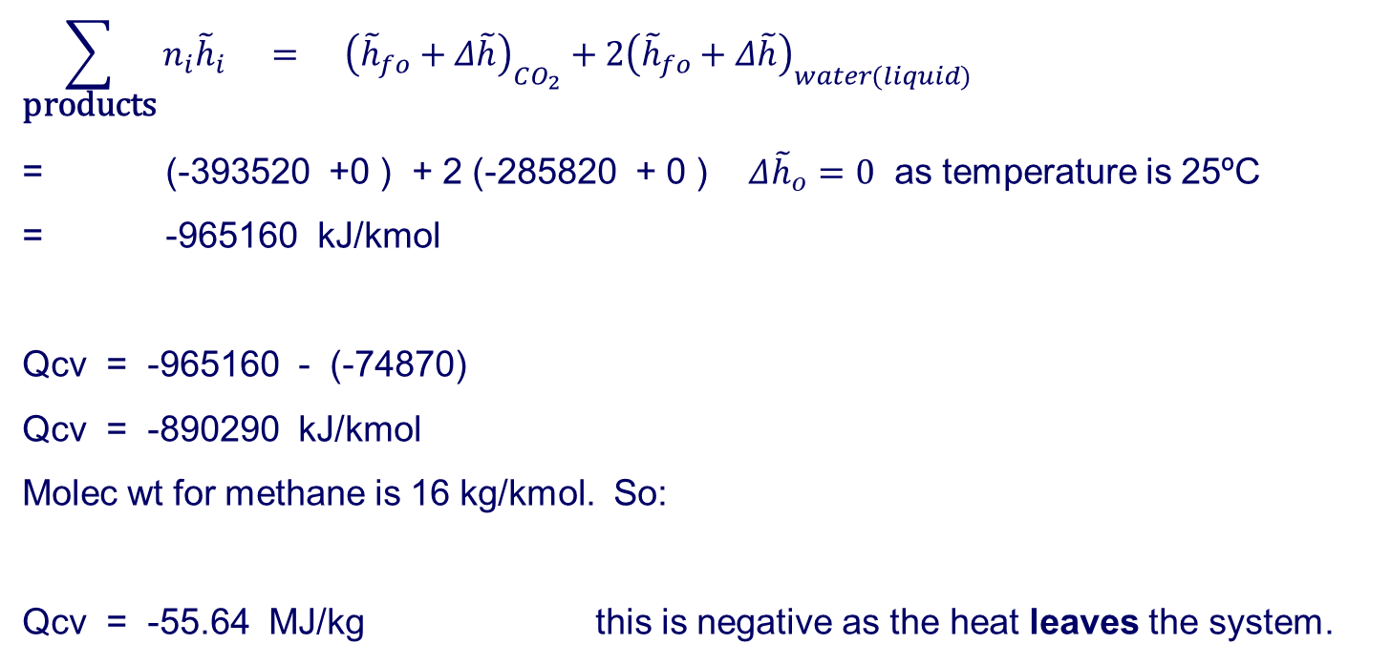
Combustion
2.2
$$\sum_{\text{products}}{n_{i}{\tilde{h}}_{i}} = {\left({\tilde{h}}_{fo}+Δ\tilde{h}\right)}_{CO_{2}}+2{\left({\tilde{h}}_{fo}+Δ\tilde{h}\right)}_{water(liquid)}$$
= (-393520 +0 ) + 2 (-285820 + 0 ) $Δ{\tilde{h}}_{o}=0$ as temperature is 25ºC
= -965160 kJ/kmol
Qcv = -965160 - (-74870)
Qcv = -890290 kJ/kmol
Molec wt for methane is 16 kg/kmol. So:
Qcv = -55.64 MJ/kg this is negative as the heat leaves the system.

Slide 26
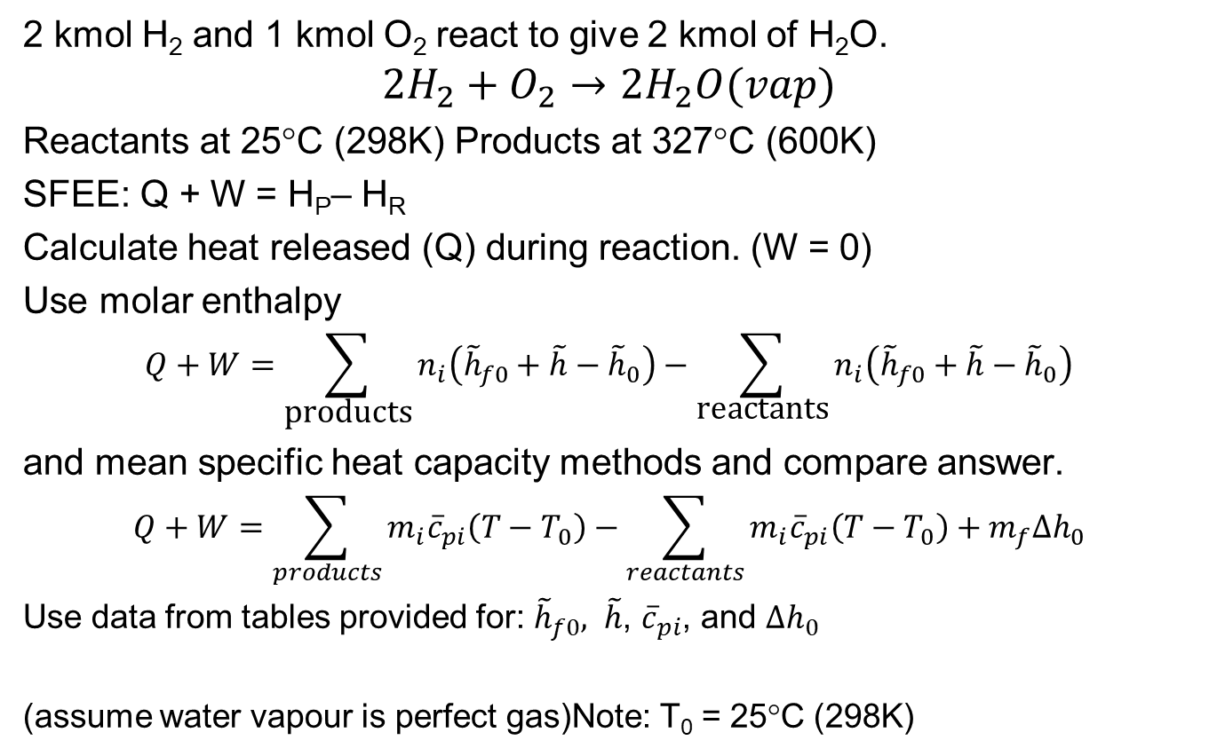
Hydrogen - not in notes
2 kmol H₂ and 1 kmol O₂ react to give 2 kmol of H₂O.
$$2H_{2}+O_{2}→2H_{2}O(vap)$$
Reactants at 25°C (298K) Products at 327°C (600K)
SFEE: Q + W = H_{P}– H_{R}
Calculate heat released (Q) during reaction. (W = 0)
Use molar enthalpy
$$Q+W=\sum_{\text{products}}{n_{i}\left({\tilde{h}}_{f0}+\tilde{h}−{\tilde{h}}_{0}\right)}−\sum_{\text{reactants}}{n_{i}\left({\tilde{h}}_{f0}+\tilde{h}−{\tilde{h}}_{0}\right)}$$
and mean specific heat capacity methods and compare answer.
$$Q+W=\sum_{products}{m_{i}{\overline{c}}_{pi}\left(T−T_{0}\right)}−\sum_{reactants}{m_{i}{\overline{c}}_{pi}\left(T−T_{0}\right)}+m_{f}∆h_{0}$$
Use data from tables provided for: ${\tilde{h}}_{f0}, \tilde{h}$, ${\overline{c}}_{pi}$, and $∆h_{0}$
(assume water vapour is perfect gas)Note: T₀ = 25°C (298K)

Slide 27
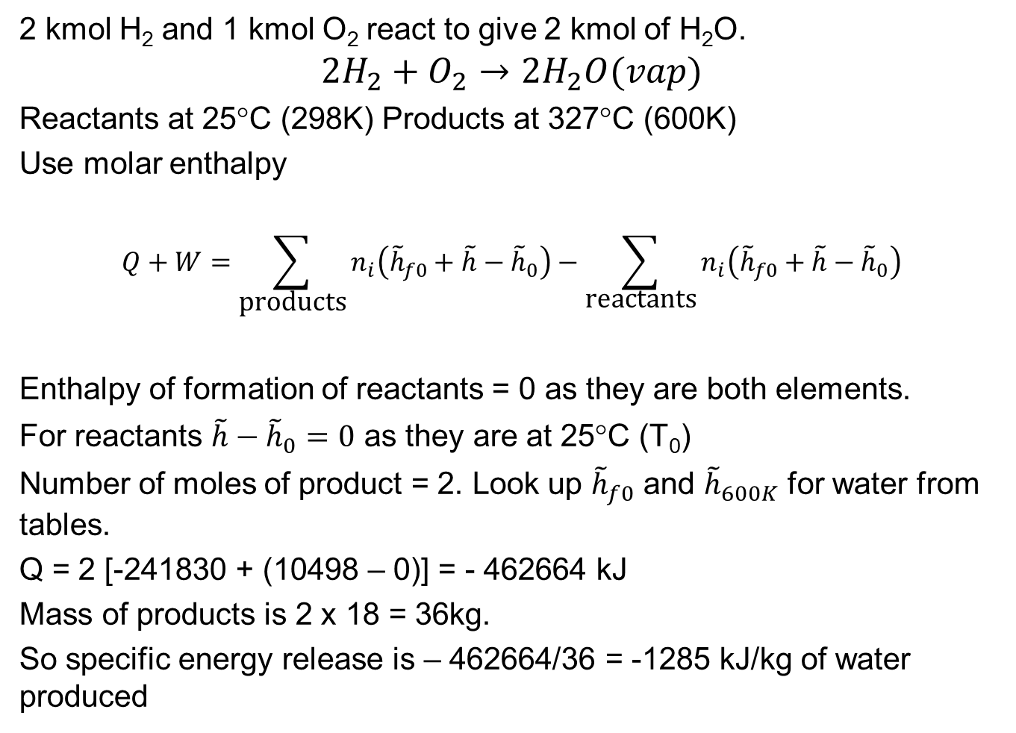
Use molar enthalpy
2 kmol H₂ and 1 kmol O₂ react to give 2 kmol of H₂O.
$$2H_{2}+O_{2}→2H_{2}O(vap)$$
Reactants at 25°C (298K) Products at 327°C (600K)
Use molar enthalpy
$$Q+W=\sum_{\text{products}}{n_{i}\left({\tilde{h}}_{f0}+\tilde{h}−{\tilde{h}}_{0}\right)}−\sum_{\text{reactants}}{n_{i}\left({\tilde{h}}_{f0}+\tilde{h}−{\tilde{h}}_{0}\right)}$$
Enthalpy of formation of reactants = 0 as they are both elements.
For reactants $\tilde{h}−{\tilde{h}}_{0}=0$ as they are at 25°C (T₀)
Number of moles of product = 2. Look up ${\tilde{h}}_{f0}$ and ${\tilde{h}}_{600K}$ for water from tables.
Q = 2 [-241830 + (10498 – 0)] = - 462664 kJ
Mass of products is 2 x 18 = 36kg.
So specific energy release is – 462664/36 = -1285 kJ/kg of water produced

Slide 28
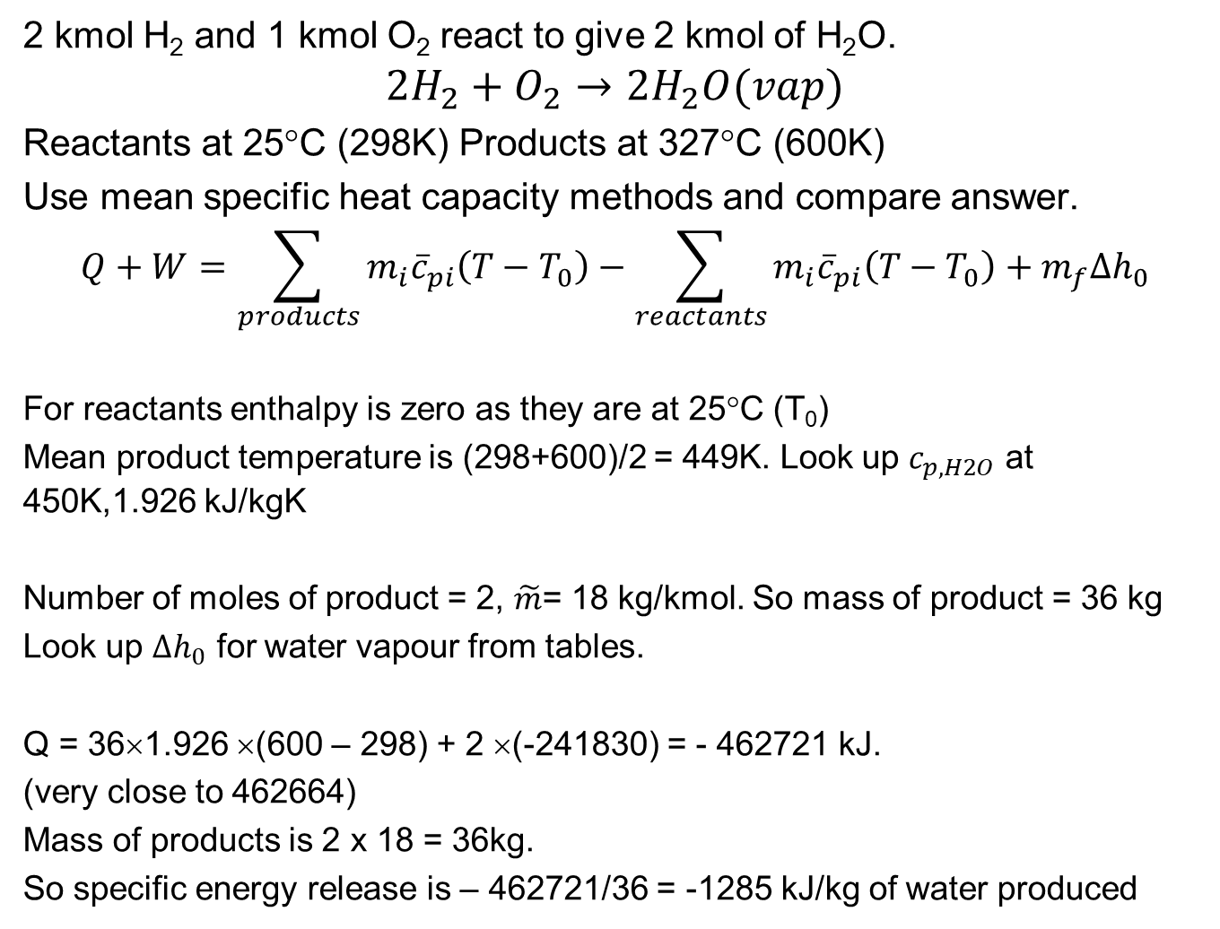
Use specific heat capacity and enthalpy of reaction
2 kmol H₂ and 1 kmol O₂ react to give 2 kmol of H₂O.
$$2H_{2}+O_{2}→2H_{2}O(vap)$$
Reactants at 25°C (298K) Products at 327°C (600K)
Use mean specific heat capacity methods and compare answer.
$$Q+W=\sum_{products}{m_{i}{\overline{c}}_{pi}\left(T−T_{0}\right)}−\sum_{reactants}{m_{i}{\overline{c}}_{pi}\left(T−T_{0}\right)}+m_{f}∆h_{0}$$
For reactants enthalpy is zero as they are at 25°C (T₀)
Mean product temperature is (298+600)/2 = 449K. Look up $c_{p,H2O}$ at 450K,1.926 kJ/kgK
Number of moles of product = 2, $\tilde{m}$= 18 kg/kmol. So mass of product = 36 kg
Look up $∆h_{0}$ for water vapour from tables.
Q = 36×1.926 ×(600 – 298) + 2 ×(-241830) = - 462721 kJ.
(very close to 462664)
Mass of products is 2 x 18 = 36kg.
So specific energy release is – 462721/36 = -1285 kJ/kg of water produced

Slide 29
Combustion – lecture 2
2.3
Learning outcomes
Understand chemical equilibrium in combustion reactions by applying 2nd Law of Thermodynamics (entropy increases when reactions take place) S increases for a reaction to happen
Understand what Gibbs Function is and its significance in determining chemical equilibrium, G=H-TS
Understand how to calculate the composition of a combustion reaction at equilibrium.
Understand the Equilibrium Constant and how it is calculated, K ^{Θ} equilibrium constant, derived from partial pressures – related to G

Slide 30
Combustion
2.3
Chemical Equilibrium (Dissociation of Products)
At equilibrium there is no tendency for spontaneous change in a system:
Thermal Equilibrium – no temperature differences
Mechanical Equilibrium – no driving forces
Chemical Equilibrium - no driving changes in composition
Thermodynamic Equilibrium – everything is in equilibrium (no energy transfers)
p₁=p₂
p₁
p₂

Slide 31
Combustion
2.3
Chemical Reactions
Chemical reactions go in both directons.
CO + ½O₂ CO₂
Final composition depends on chemical equilibrium when driving forces in each direction are equal.
CO + ½ O₂ ⇒ (1-a)CO₂ + aCO + ½ aO₂
Equilibrium composition (value of a) can be found by considering entropy changes and 2nd Law of Thermodynamics.
O₂
O₂
CO
CO
CO₂
CO₂
CO₂
CO
CO₂
O₂
O₂

Slide 32



Combustion
2.3
Entropy generation rate
At steady state:
$${\dot{S}}_{generation}={\dot{S}}_{system}+{\dot{S}}_{surroundings}$$
$${\dot{S}}_{system}^{}=0$$
$${\dot{S}}_{surround}=\frac{{\dot{Q}}_{sys}}{T}−\sum_{reactants}{{\dot{m}}_{ri}s_{ri}+\sum_{products}{{\dot{m}}_{pi}s_{pi}}}$$
$${\dot{S}}_{surroundings}=\frac{\dot{Q_{sys}}}{T}−\sum_{reactants}{{\dot{m}}_{ri}s_{ri}+\sum_{products}{{\dot{m}}_{pi}s_{pi}≥0}}$$

Slide 33
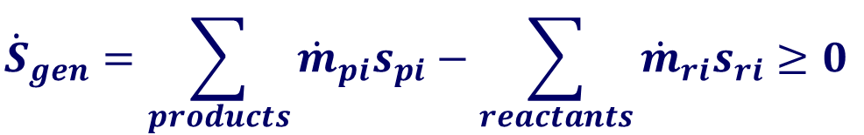
Combustion
2.3
$${\dot{S}}_{gen}=\sum_{products}{{\dot{m}}_{pi}s_{pi}−\sum_{reactants}{{\dot{m}}_{ri}s_{ri}≥0}}$$
Adiabatic Reaction
Reaction proceeds until entropy is a maximum.
Equilibrium state is at maximum entropy.
dS = 0
S_{gen}
dS<0
dS>0
impossible
100%
Reactants
Equilibrium
composition
100%
Products

Slide 34

Combustion
2.3
Chemical Reaction at specified temperature and pressure:
From the 1st Law
-dQ + dW = dU (NFEE) but dW = -pdV
So -dQ -pdV = dU
From 2nd Law:
dS_{gen} = dS_{sys} + dS_{surr} ≥ 0 (dS_{surr} = dQ/T)
dS_{gen} = dS_{sys} + dQ/T ≥ 0
TdS_{sys} ≥ -dQ
Substitute for dQ in 1st Law expression:
(dU + pdV) - TdS_{sys} ≤ 0 → (H – TS) ≤ 0 (2)
$$d\dot{Q}$$
Combustion Chamber
(system) (T,P)
At constant temperature and pressure

Slide 35
Combustion
2.3
Chemical Reaction at constant temperature and pressure:
Now define a new quantity Gibbs Function G = H – TS
(also known as free energy or chemical potential)
To obey the second law of thermodynamics it is found that (derivation in notes):
dG_{(T,p)} ≤ 0
Equilibrium state is at minimum Gibbs function

Slide 36
Combustion
2.3
So chemical reactions proceed until the Gibbs function is a minimum to obey 2nd Law.
G_{(T,p)}
dG = 0
dG<0
dG>0
impossible
100%
Reactants
Equilibrium
composition
100%
Products
dG_{(T,p)} ≤ 0
Equilibrium state is at minimum Gibbs function

Slide 37
Combustion
2.3
Equilibrium composition – use minimum Gibbs function approach
Chemical reaction aA + bB → cC + dD
Reaction proceeds a little dn_{A} A + dn_{B} B → dn_{C} C + dn_{d} D
Equilibrium is reached when dG_{(T,p)} = 0
dn_{A} = -ε a ε is small reaction progressing a small amount
dn_{B} = -ε b
dn_{C} = +ε c
dn_{D} = +ε d
all at T,p

Slide 38
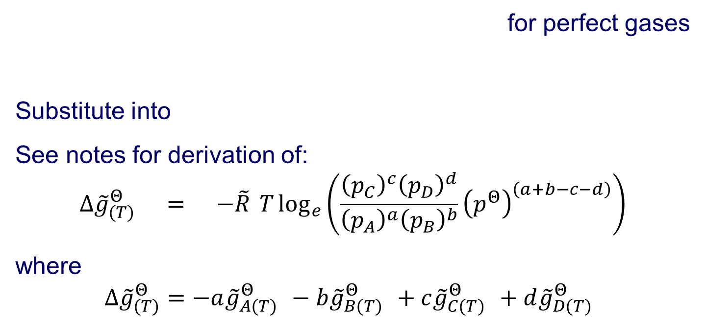
Combustion
2.3
for perfect gases
Substitute into
See notes for derivation of:
$$Δ{\tilde{g}}_{(T)}^{Θ} = −\tilde{R} T\log_{e}\left(\frac{{\left(p_{C}\right)}^{c}{\left(p_{D}\right)}^{d}}{{\left(p_{A}\right)}^{a}{\left(p_{B}\right)}^{b}}{\left(p^{Θ}\right)}^{\left(a+b−c−d\right)}\right)$$
where
$$Δ{\tilde{g}}_{(T)}^{Θ}=−a{\tilde{g}}_{A(T)}^{Θ} −b{\tilde{g}}_{B(T)}^{Θ} +c{\tilde{g}}_{C(T)}^{Θ} +d{\tilde{g}}_{D(T)}^{Θ}$$

Slide 39
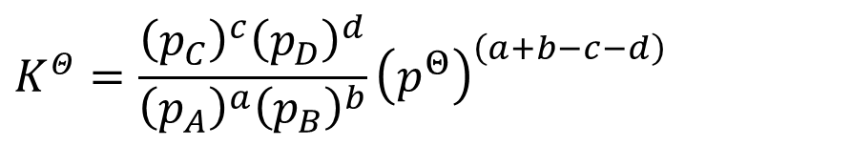
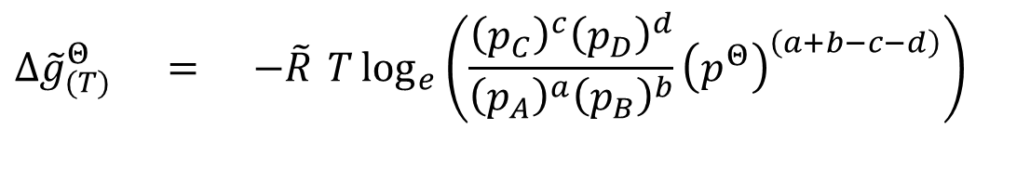
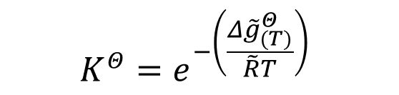
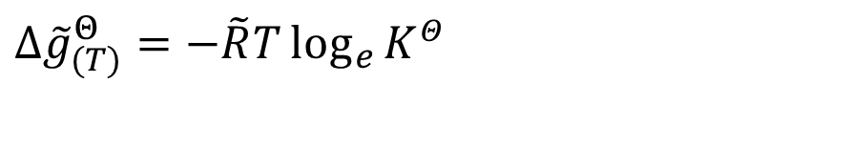
Combustion
2.3
$$Δ{\tilde{g}}_{(T)}^{Θ} = −\tilde{R} T\log_{e}\left(\frac{{\left(p_{C}\right)}^{c}{\left(p_{D}\right)}^{d}}{{\left(p_{A}\right)}^{a}{\left(p_{B}\right)}^{b}}{\left(p^{Θ}\right)}^{\left(a+b−c−d\right)}\right)$$
Equilibrium constant is defined as:
$$K^{Θ}=\frac{{\left(p_{C}\right)}^{c}{\left(p_{D}\right)}^{d}}{{\left(p_{A}\right)}^{a}{\left(p_{B}\right)}^{b}}{\left(p^{Θ}\right)}^{\left(a+b−c−d\right)}$$
$$Δ{\tilde{g}}_{(T)}^{Θ}=−\tilde{R}T\log_{e}{K^{Θ}}$$
$$K^{Θ}=e^{−\left(\frac{Δ{\tilde{g}}_{(T)}^{Θ}}{\tilde{R}T}\right)}$$

Slide 40
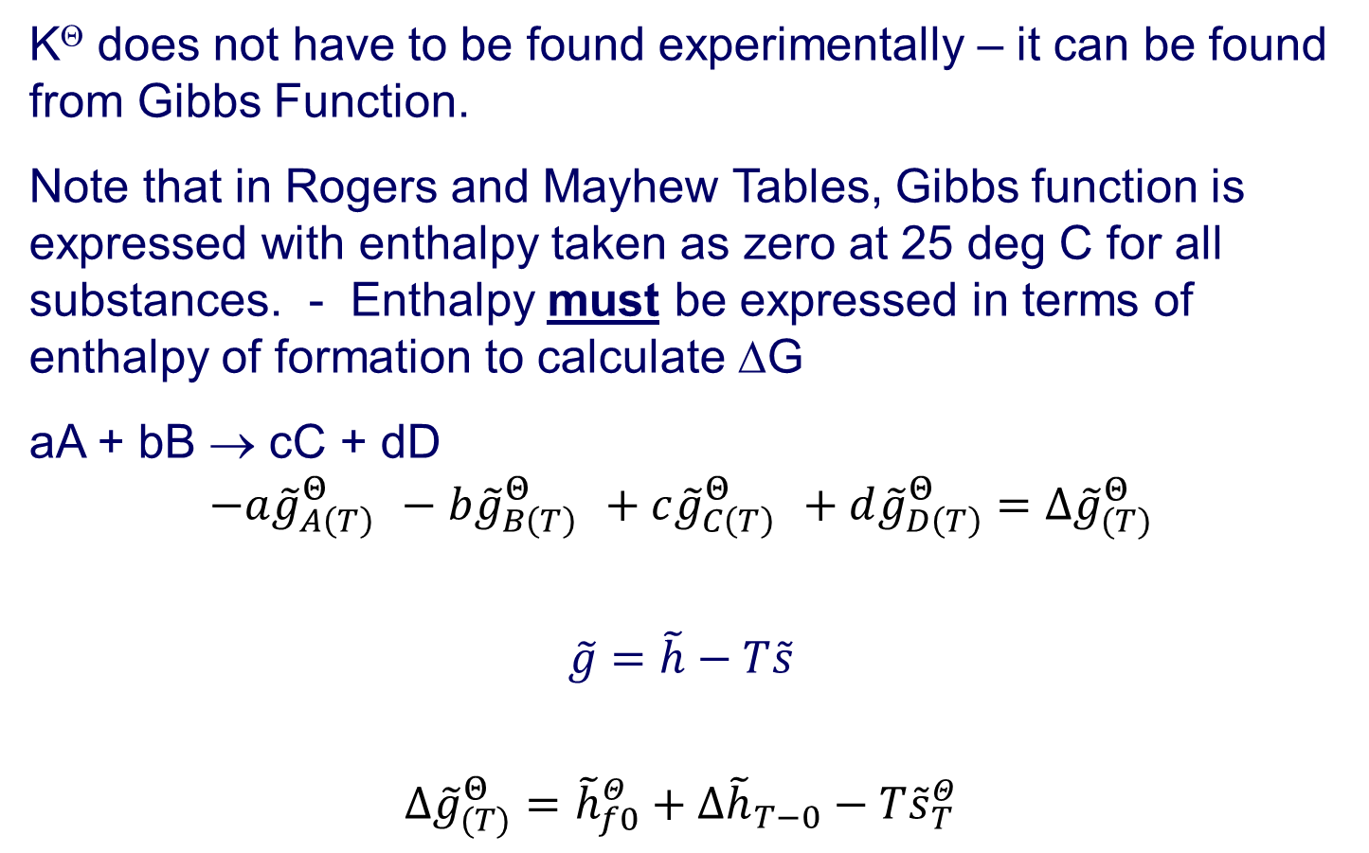
Combustion
2.3
K^{Θ} does not have to be found experimentally – it can be found from Gibbs Function.
Note that in Rogers and Mayhew Tables, Gibbs function is expressed with enthalpy taken as zero at 25 deg C for all substances. - Enthalpy must be expressed in terms of enthalpy of formation to calculate ΔG
aA + bB → cC + dD
$$−a{\tilde{g}}_{A\left(T\right)}^{Θ} −b{\tilde{g}}_{B\left(T\right)}^{Θ} +c{\tilde{g}}_{C\left(T\right)}^{Θ} +d{\tilde{g}}_{D\left(T\right)}^{Θ}=Δ{\tilde{g}}_{(T)}^{Θ}$$
$$\tilde{g}=\tilde{h}−T\tilde{s}$$
$$Δ{\tilde{g}}_{(T)}^{Θ}={\tilde{h}}_{f0}^{Θ}+∆{\tilde{h}}_{T−0}−T{\tilde{s}}_{T}^{Θ}$$

Slide 41
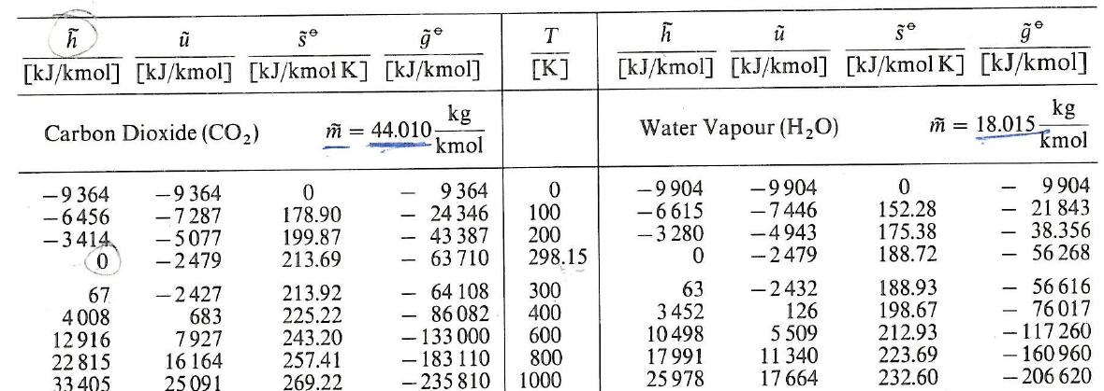
The Plimsoll line saves lives!

Slide 42
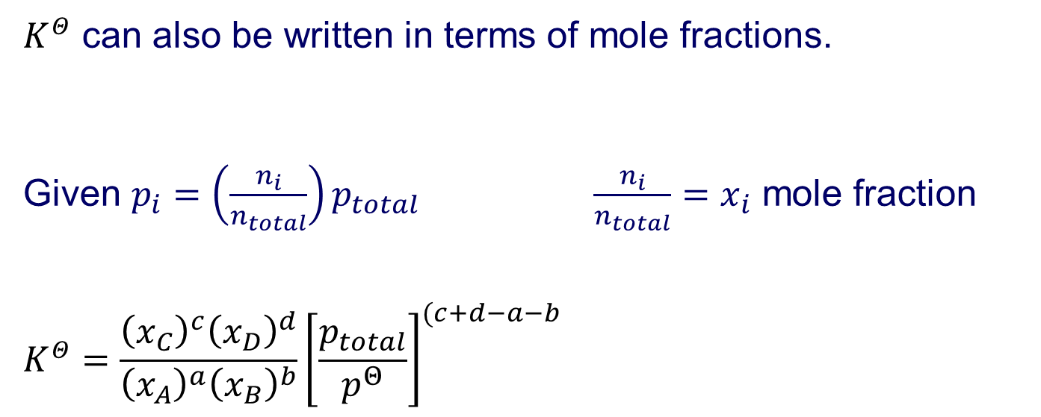
Combustion
2.3
$K^{Θ}$ can also be written in terms of mole fractions.
Given $p_{i}=\left(\frac{n_{i}}{n_{total}}\right)p_{total}$ $\frac{n_{i}}{n_{total}}=x_{i}$ mole fraction
$$K^{Θ}=\frac{{\left(x_{C}\right)}^{c}{\left(x_{D}\right)}^{d}}{{\left(x_{A}\right)}^{a}{\left(x_{B}\right)}^{b}}{\left[\frac{p_{total}}{p^{Θ}}\right]}^{(c+d−a−b}$$

Slide 43
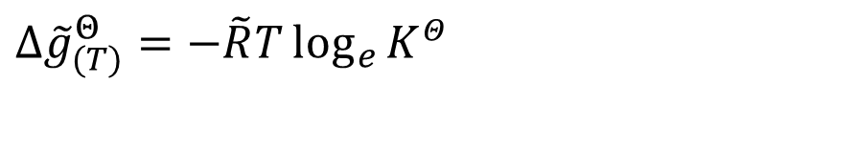
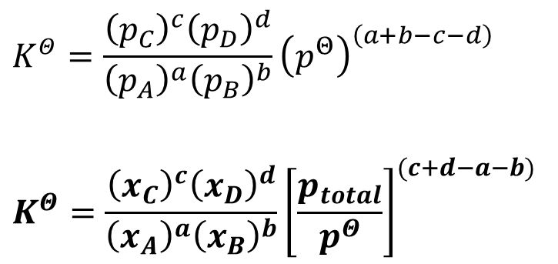
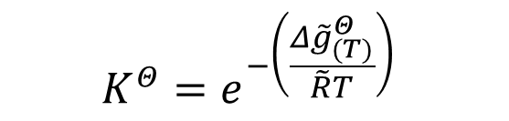
Combustion
2.3
Equilibrium constant is defined as:
a, b, c, d are the powers which are the mole number of each of the species in the completed stoichiometric reaction equation. The actual mole proportions at equilibrium are x_{a} etc.
$$K^{Θ}=\frac{{\left(p_{C}\right)}^{c}{\left(p_{D}\right)}^{d}}{{\left(p_{A}\right)}^{a}{\left(p_{B}\right)}^{b}}{\left(p^{Θ}\right)}^{\left(a+b−c−d\right)}$$
$$K^{Θ}=\frac{{\left(x_{C}\right)}^{c}{\left(x_{D}\right)}^{d}}{{\left(x_{A}\right)}^{a}{\left(x_{B}\right)}^{b}}{\left[\frac{p_{total}}{p^{Θ}}\right]}^{(c+d−a−b)}$$
$$Δ{\tilde{g}}_{(T)}^{Θ}=−\tilde{R}T\log_{e}{K^{Θ}}$$
$$K^{Θ}=e^{−\left(\frac{Δ{\tilde{g}}_{(T)}^{Θ}}{\tilde{R}T}\right)}$$

Slide 44

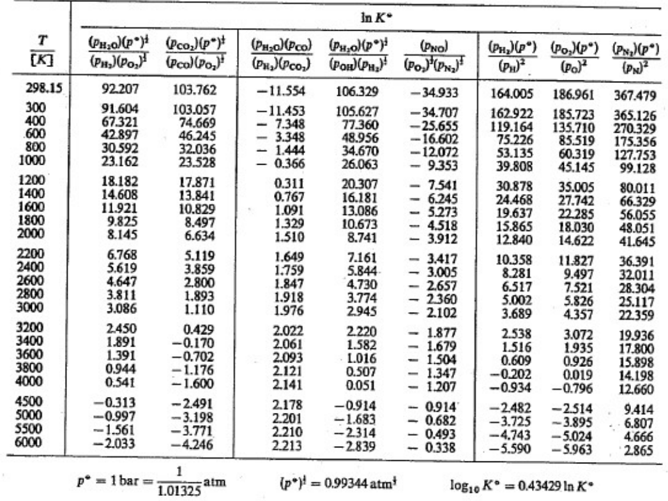

Slide 45
Combustion – Lecture 3
Learning outcomes
Understand the properties of the Equilibrium Constant and how to use it.

Slide 46

$$K^{Θ}=\frac{{\left(p_{C}\right)}^{c}{\left(p_{D}\right)}^{d}}{{\left(p_{A}\right)}^{a}{\left(p_{B}\right)}^{b}}{\left(p^{Θ}\right)}^{\left(a+b−c−d\right)}$$
$$K^{Θ}=e^{−\left(\frac{Δ{\tilde{g}}_{(T)}^{Θ}}{\tilde{R}T}\right)}$$
Combustion
2.3
K^{Θ} applies only to mixtures of perfect gases.
K^{Θ} is DEPENDENT upon temperature
K^{Θ} is INDEPENDENT of pressure. ΔG_{(T)} is evaluated at standard pressure of 1 bar, so K^{Θ} is independent of pressure of mixture. BUT……….
Total pressure of the mixture of gases affects the composition.
Presence of gases which do not take part in the reaction does not affect K^{Θ}, but does affect equilibrium composition, by affecting partial pressures.
If K^{Θ} is large the reaction will be more towards the products side and vice versa. aA + bB → cC + dD
K^{Θ} indicates the equilibrium composition but gives no indication as to how fast equilibrium is reached. The rate can only be determined from chemical kinetics theory.

Slide 47
Combustion
2.3
When is Dissociation important?
If K^{Θ} is very large the composition will tend towards the products side.
If K^{Θ} is very small the composition will tend towards the reactants side.
Generally if K^{Θ} > 1000 (ie log_{e} K^{Θ} >7) then the reaction may be assumed to have gone to completion for the purposes of calculating temperatures and enthalpies in the reactions. (If K^{Θ} is = 1000 then this implies that the partial pressure, and hence mole fraction, of the products is 1000 times that of the reactants at equilibrium)
Similarly if K^{Θ} < 0.001 (ie loge K^{Θ} < -7) then the reaction may be assumed not to have taken place.
Examples:
See p 21 in Rogers and Mayhew tables for values of K^{Θ}.
Dissociation of H₂O into H₂ and O₂ is only important when T > 2000 K.
Dissociation of O₂ into atomic O is only important when T > 2600 K
Dissociation of N₂ into atomic N is only important when T > 5000 K
Dissociation of CO₂ into CO and O₂ is only important when T > 1800 K
Reaction of N₂ and O₂ to form NO is only important when T > 1000 K
Reaction of H₂O and CO to form H₂ and CO₂ is only important when T > 400 K
(but CO will not usually be present if there is plenty of O₂ about)

Slide 48
Combustion
2.3
Examples
See p 21 in Rogers and Mayhew tables for values of K^{Θ}.
Dissociation of H₂O into H₂ and O₂ is only important when T > 2000 K.
Dissociation of O₂ into atomic O is only important when T > 2600 K
Dissociation of N₂ into atomic N is only important when T > 5000 K
Dissociation of CO₂ into CO and O₂ is only important when T > 1800 K
Reaction of N₂ and O₂ to form NO is only important when T > 1000 K
Reaction of H₂O and CO to form H₂ and CO₂ is only important when T > 400 K
(but CO will not usually be present if there is plenty of O₂ about)

Slide 49
Combustion
Competing reactions: solve reactions simultaneously.
Examples:
(i) H₂ + ½O₂ ⇔ H₂O Reaction of H₂ and O₂ to form water
A B C
a = 1
b = 0.5
c = 1
(ii) ½O₂ + ½N₂ ⇔ NO
A B C
a = 0.5
b = 0.5
c = 1
(iv) Alternatively for (i) we could write:
(iii) ½O₂ ⇔ O 2H₂ + O₂ ⇔ 2H₂O
A C A B C
a = 0.5 a = 2
c = 1 b = 1
c = 2

Slide 50
Combustion
Form of stoichiometric equation is important
(i) ½O₂ + ½N₂ ⇔ NO
A B C
a = 0.5
b = 0.5
c = 1
OR
(ii) O₂ + N₂ ⇔ 2NO
A B C
a = 1
b = 1
c = 2
In tables K is written for stoichiometric equation (i) So you must use that equation in
determining equilibrium composition.

Slide 51
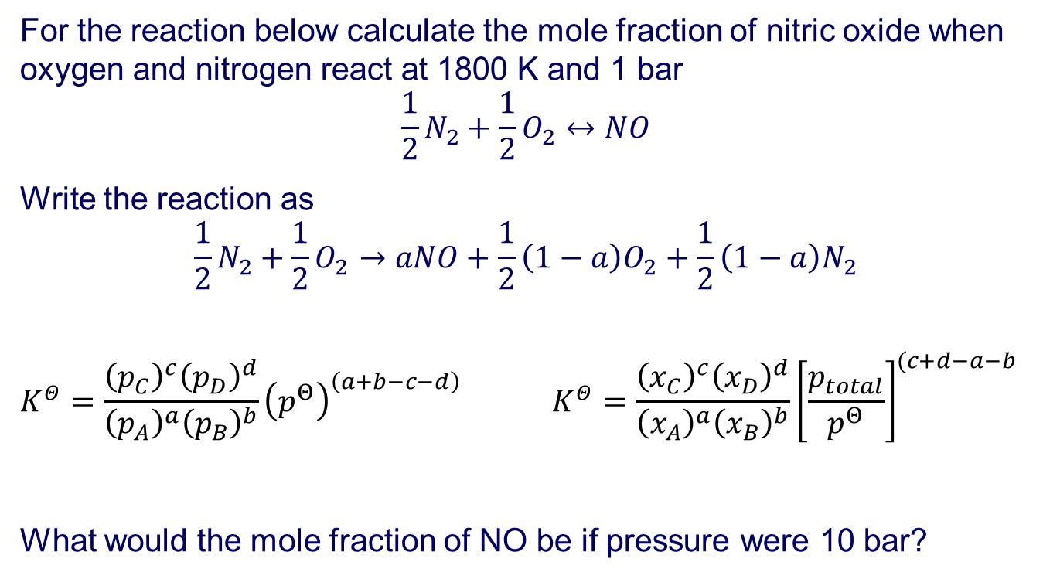
Combustion
For the reaction below calculate the mole fraction of nitric oxide when oxygen and nitrogen react at 1800 K and 1 bar
$$\frac{1}{2}N_{2}+\frac{1}{2}O_{2}↔NO$$
Write the reaction as
$$\frac{1}{2}N_{2}+\frac{1}{2}O_{2}→aNO+\frac{1}{2}\left(1−a\right)O_{2}+\frac{1}{2}\left(1−a\right)N_{2}$$
$$K^{Θ}=\frac{{\left(p_{C}\right)}^{c}{\left(p_{D}\right)}^{d}}{{\left(p_{A}\right)}^{a}{\left(p_{B}\right)}^{b}}{\left(p^{Θ}\right)}^{\left(a+b−c−d\right)} K^{Θ}=\frac{{\left(x_{C}\right)}^{c}{\left(x_{D}\right)}^{d}}{{\left(x_{A}\right)}^{a}{\left(x_{B}\right)}^{b}}{\left[\frac{p_{total}}{p^{Θ}}\right]}^{(c+d−a−b}$$
What would the mole fraction of NO be if pressure were 10 bar?

Slide 52
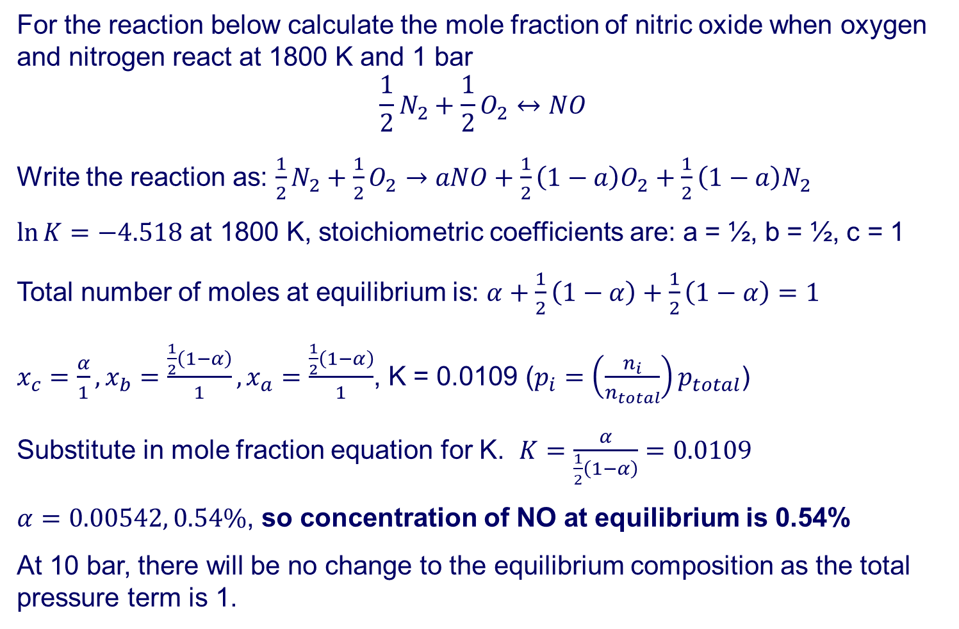
Combustion
For the reaction below calculate the mole fraction of nitric oxide when oxygen and nitrogen react at 1800 K and 1 bar
$$\frac{1}{2}N_{2}+\frac{1}{2}O_{2}↔NO$$
Write the reaction as: $\frac{1}{2}N_{2}+\frac{1}{2}O_{2}→aNO+\frac{1}{2}\left(1−a\right)O_{2}+\frac{1}{2}\left(1−a\right)N_{2}$
$\ln{K}=−4.518$ at 1800 K, stoichiometric coefficients are: a = ½, b = ½, c = 1
Total number of moles at equilibrium is: $α+\frac{1}{2}\left(1−α\right)+\frac{1}{2}\left(1−α\right)=1$
$x_{c}=\frac{α}{1}, x_{b}=\frac{\frac{1}{2}\left(1−α\right)}{1},x_{a}=\frac{\frac{1}{2}\left(1−α\right)}{1}$, K = 0.0109 ($p_{i}=\left(\frac{n_{i}}{n_{total}}\right)p_{total}$)
Substitute in mole fraction equation for K. $K=\frac{α}{\frac{1}{2}\left(1−α\right)}=0.0109$
$α=0.00542, 0.54\%$, so concentration of NO at equilibrium is 0.54%
At 10 bar, there will be no change to the equilibrium composition as the total pressure term is 1.

Slide 53
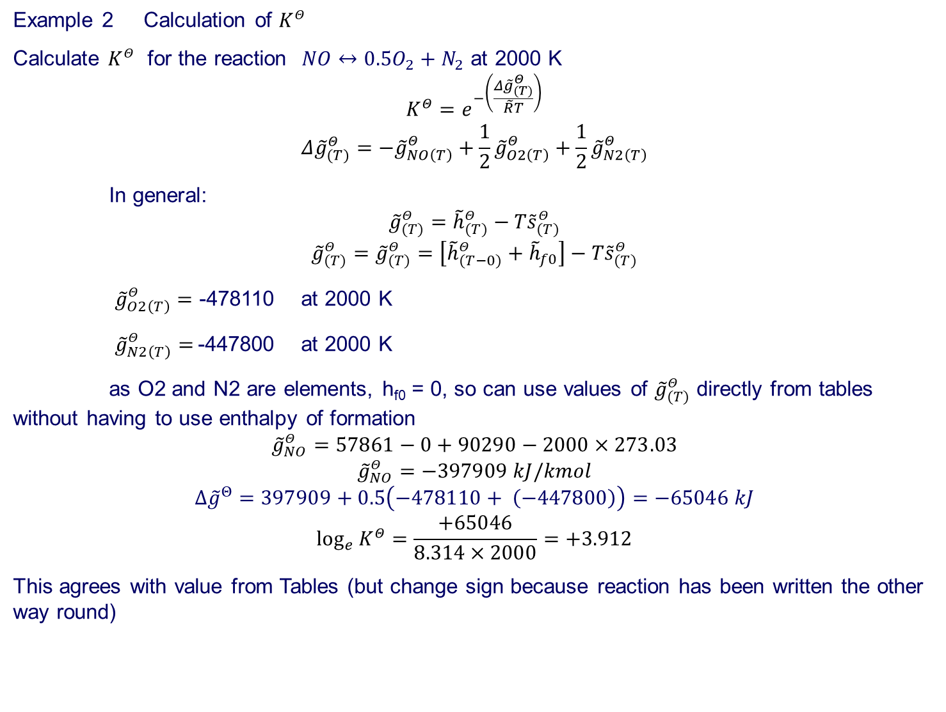
Combustion
Example 2 Calculation of $K^{Θ}$
Calculate $K^{Θ}$ for the reaction $NO↔0.5O_{2}+N_{2}$ at 2000 K
$$K^{Θ}=e^{−\left(\frac{Δ{\tilde{g}}_{(T)}^{Θ}}{\tilde{R}T}\right)}$$
$$Δ{\tilde{g}}_{(T)}^{Θ}=−{\tilde{g}}_{NO\left(T\right)}^{Θ}+\frac{1}{2}{\tilde{g}}_{O2\left(T\right)}^{Θ}+\frac{1}{2}{\tilde{g}}_{N2\left(T\right)}^{Θ}$$
In general:
$${\tilde{g}}_{(T)}^{Θ}={\tilde{h}}_{(T)}^{Θ}−T{\tilde{s}}_{(T)}^{Θ}$$
$${\tilde{g}}_{(T)}^{Θ}={\tilde{g}}_{(T)}^{Θ}=\left[{\tilde{h}}_{(T−0)}^{Θ}+{\tilde{h}}_{f0}\right]−T{\tilde{s}}_{(T)}^{Θ}$$
${\tilde{g}}_{O2\left(T\right)}^{Θ}=$ -478110 at 2000 K
${\tilde{g}}_{N2\left(T\right)}^{Θ}=$-447800 at 2000 K
as O2 and N2 are elements, h_{f0} = 0, so can use values of ${\tilde{g}}_{(T)}^{Θ}$ directly from tables without having to use enthalpy of formation
$${\tilde{g}}_{NO}^{Θ}=57861−0+90290−2000×273.03$$
$${\tilde{g}}_{NO}^{Θ}=−397909 kJ/kmol$$
$$∆{\tilde{g}}^{Θ}=397909+0.5\left(−478110+ \left(−447800\right)\right)=−65046 kJ$$
$$\log_{e}{K^{Θ}}=\frac{+65046}{8.314×2000}=+3.912$$
This agrees with value from Tables (but change sign because reaction has been written the other way round)

Slide 54
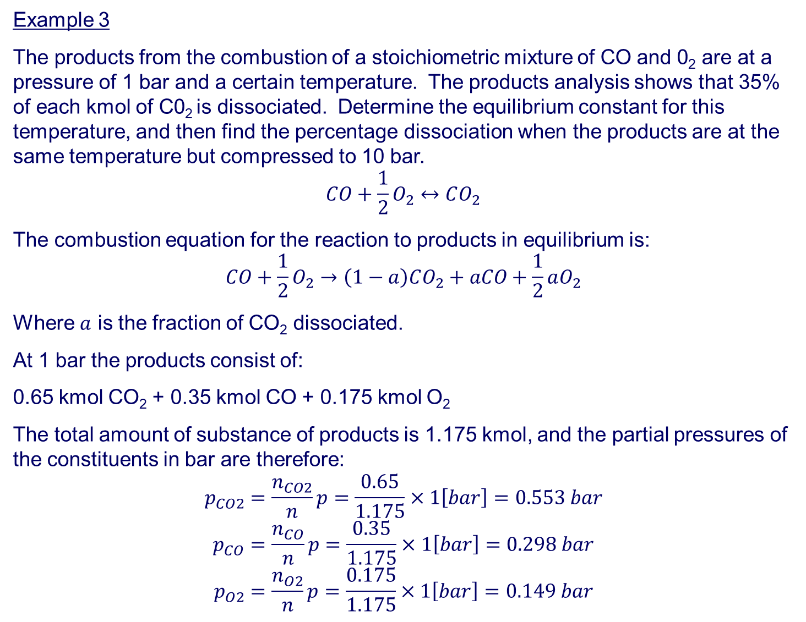
Example 3
The products from the combustion of a stoichiometric mixture of CO and 0₂ are at a pressure of 1 bar and a certain temperature. The products analysis shows that 35% of each kmol of C0₂ is dissociated. Determine the equilibrium constant for this temperature, and then find the percentage dissociation when the products are at the same temperature but compressed to 10 bar.
$$CO+\frac{1}{2}O_{2}↔CO_{2}$$
The combustion equation for the reaction to products in equilibrium is:
$$CO+\frac{1}{2}O_{2}→\left(1−a\right)CO_{2}+aCO+\frac{1}{2}aO_{2}$$
Where $a$ is the fraction of CO₂ dissociated.
At 1 bar the products consist of:
0.65 kmol CO₂ + 0.35 kmol CO + 0.175 kmol O₂
The total amount of substance of products is 1.175 kmol, and the partial pressures of the constituents in bar are therefore:
$$p_{CO2}=\frac{n_{CO2}}{n}p=\frac{0.65}{1.175}×1\left[bar\right]=0.553 bar$$
$$p_{CO}=\frac{n_{CO}}{n}p=\frac{0.35}{1.175}×1\left[bar\right]=0.298 bar$$
$$p_{O2}=\frac{n_{O2}}{n}p=\frac{0.175}{1.175}×1\left[bar\right]=0.149 bar$$

Slide 55
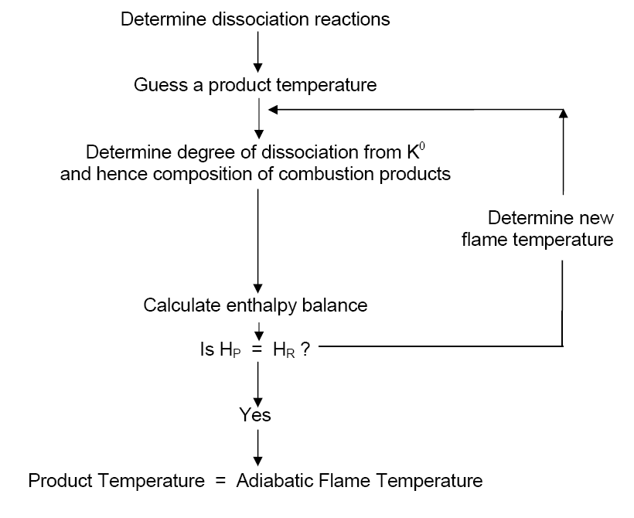
Calculate Adiabatic Flame Temperature – allowing for chemical equilibrium for combustion at constant pressure
Is H_{p} = H_{r}+mΔh₀?

